Slide 1
CSC3047 IT Enterprise Project
Dr Darryl Stewart
Dr Barry McCollum
Dr Paul McMullan

Slide 2
IT Enterprise Project
Individual Research Project
1st Semester Issues
Development Project
Teams
Requirements
Supervision
Deliverables
Final Report
Assessment

Slide 3
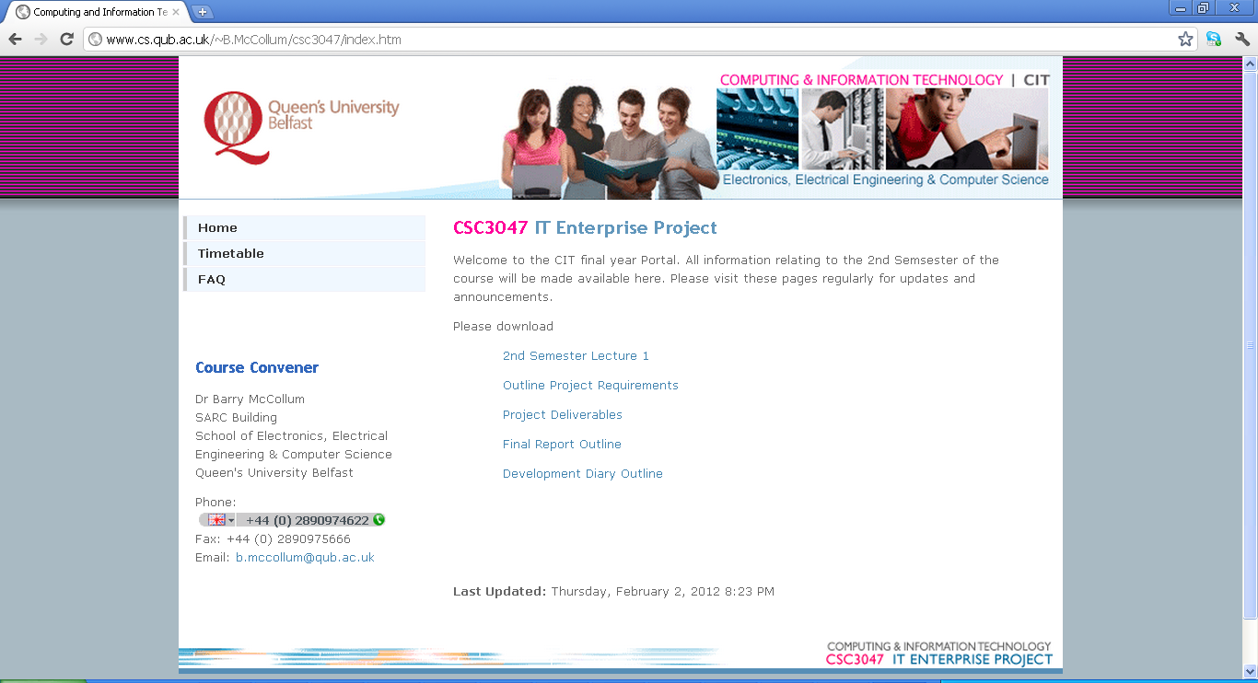
Questions?

Slide 4
IT Enterprise Project
Requirements
Students
Academics
Administrators
Academic Programme Managers

Slide 5
IT Enterprise Project
Deliverables
Group Presentation
System Demonstration
Final Report
System

Slide 6
IT Enterprise Project
Final Report
Project Management
Requirements Specification
User Interface Design
Database Design
System Design
Coding Standards and Convention
Unit Implementation
Quality Assurance
Critical Evaluation

Slide 7
Supervision
Meetings with one of the Customers/Supervisors
Dr Barry McCollum
Dr Paul McMullan
Questions
Progress monitoring
Meetings begin Tuesday 13th

Slide 8
Element | Percentage | Type
Group Presentation & System Demonstration | 15% | Group
2. Final Report & System Produced | 30% | Group
3. Development Diary | 15% | Individual

